Slide 1
Employee Self Service (ESS)
(v2020)
Early Adoption
Notes:
Let’s jump right into ESS, which is now in Early Adoption. <next>

Slide 2
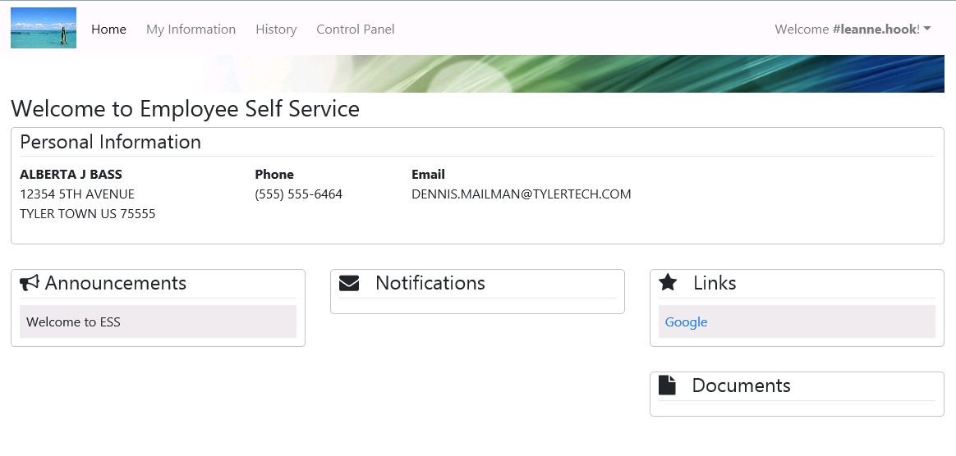
ESS - Employee Landing Page
Notes:
After an employee logs into ESS, this is the landing page they will see. It shows some basic information. We also have a space for important employee announcements, such as benefit enrollment deadlines, a space for notifications, and spaces for helpful links and documentation. <next>

Slide 3
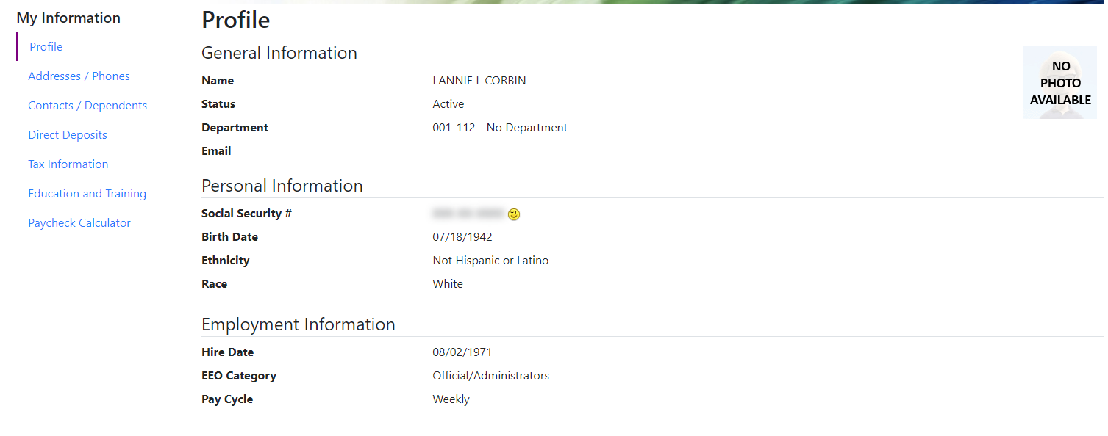
ESS – Employee Profile
Notes:
Under my information, the employee can see some general information, such as name, department, hire date. <next>

Slide 4
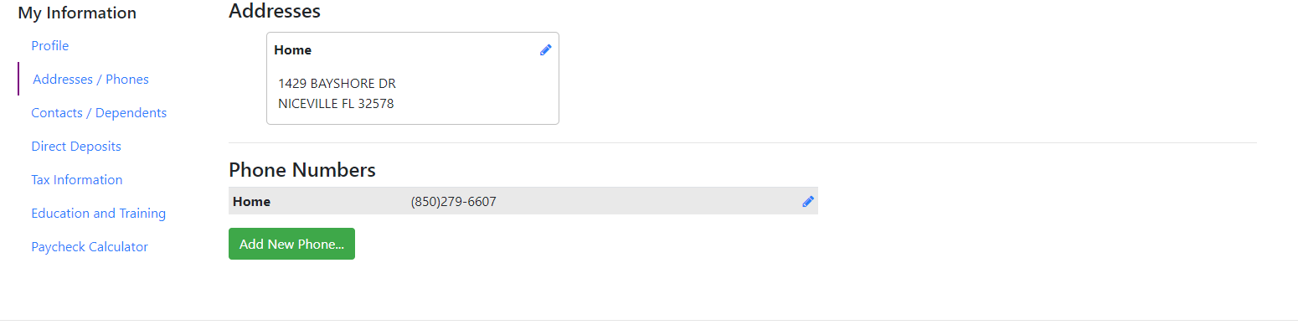
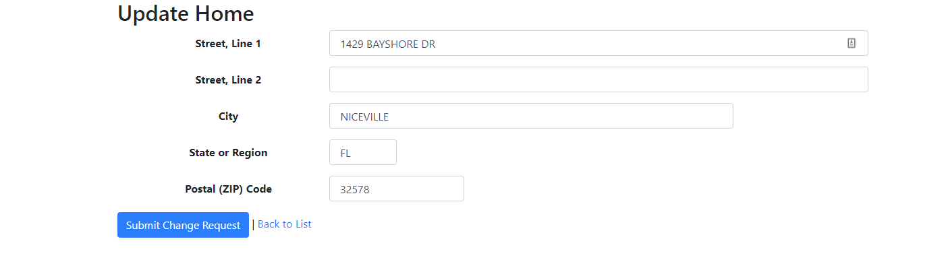
ESS – Employee Address/Phone
Notes:
Employees can edit address with the pencil icon. <next>
Employees can edit phone number with the pencil icon.
Employees can add a new phone number with the green button. <next>
The blue ‘Submit Change Request’ button will send the request down to a new queue within the Payroll application for a supervisor to review and approve/reject. <next>

Slide 5
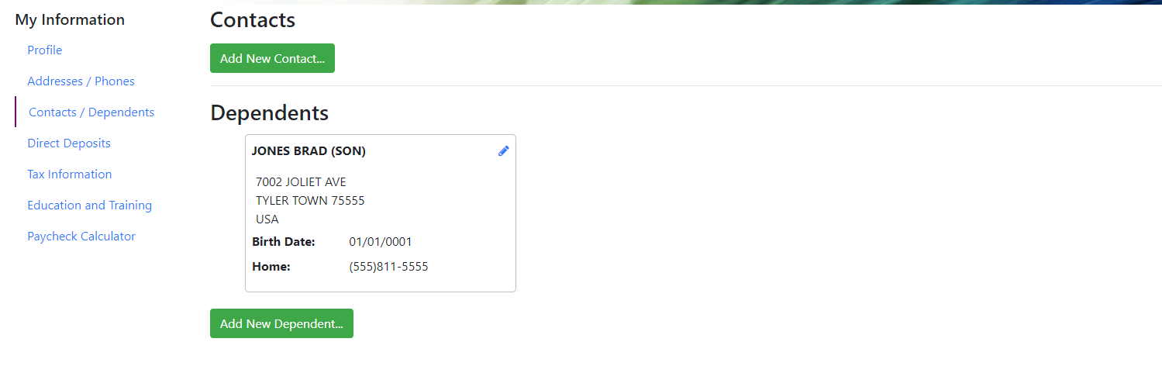
ESS – Emergency Contacts and Dependents
Notes:
Employees can add a new contact using the green button. <next>
Must have HR for Dependents
Employees can edit the dependent with the pencil icon
Employees can add a new dependent with the green button. <next>

Slide 6
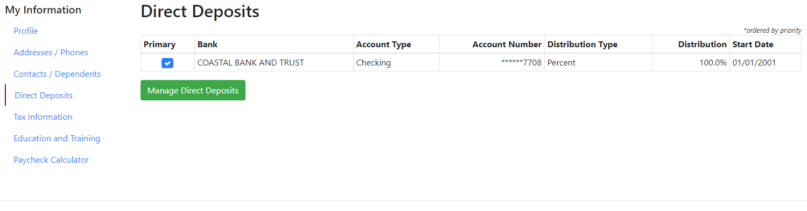
ESS – Employee Direct Deposits
Notes:
Employees can update their bank account information on the Direct Deposit page. <next>

Slide 7
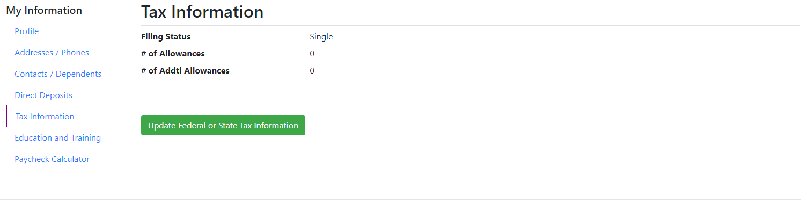
ESS – Employee Tax Information
Notes:
Employees can also make tax allowance changes on ESS. <next>

Slide 8
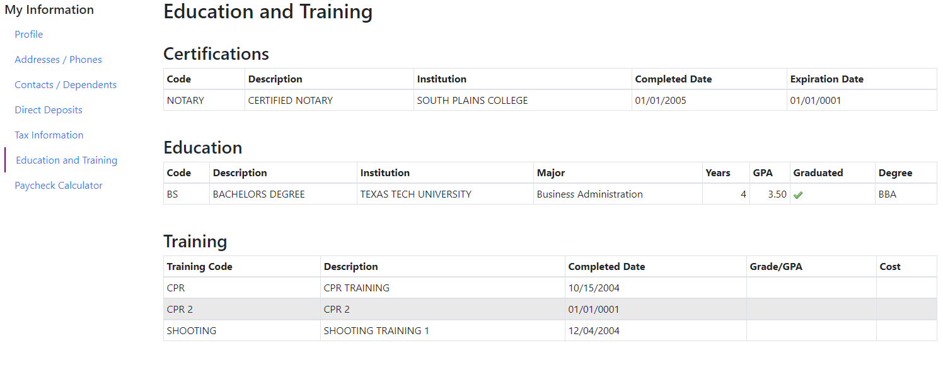
Education and Training
Notes:
We can also show the certifications, education, and trainings the employee has received. This information pulls from the Human Resources application. Must be licensed for HR for information to be displayed on this page. . <next>

Slide 9
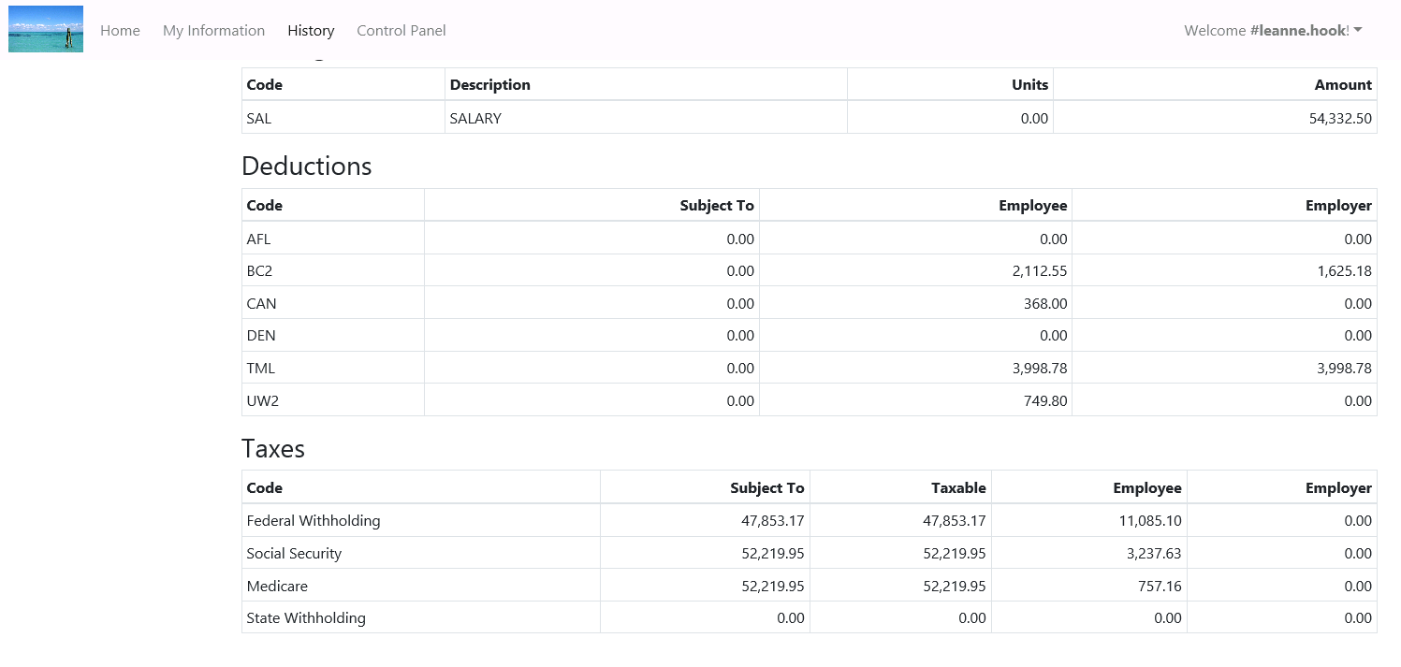
ESS – Employee Pay History Summary
Notes:
The first page on the History section is the Pay History Summary. Here employees can see pay summary information for their pay codes, deductions, and taxes. <next>

Slide 10
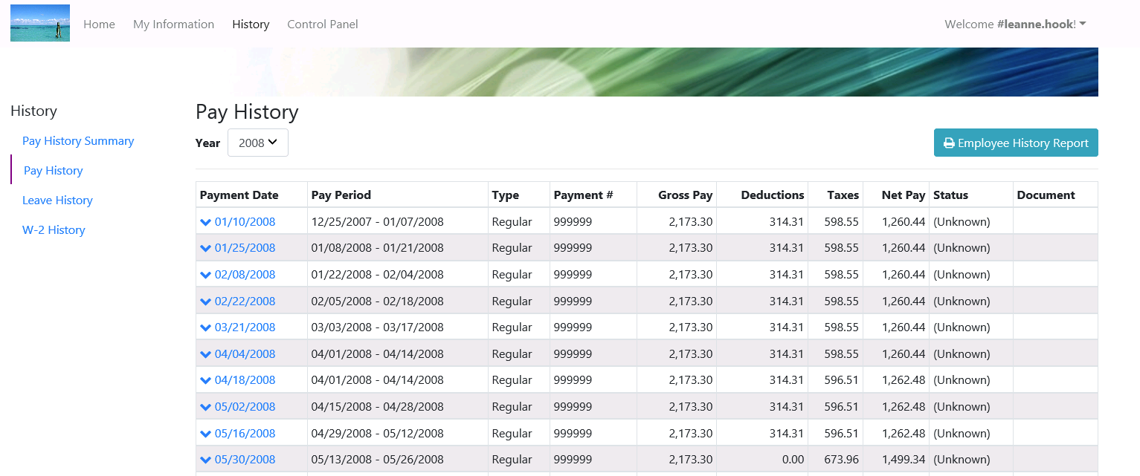
ESS – Pay History
Notes:
On the Pay History screen, employees can see their detailed pay history. The Payment Date is a hyperlink. <next>

Slide 11
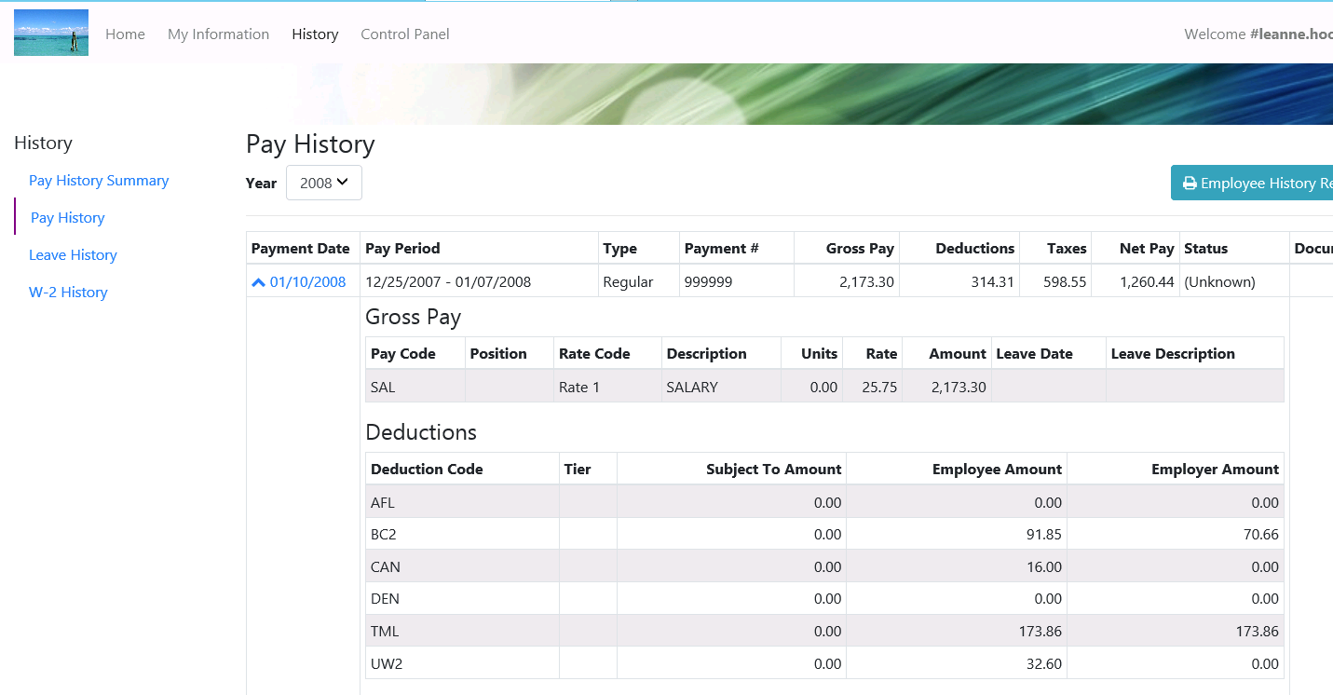
ESS – Pay History Check Drilldown
Notes:
If the employee clicks on that date, it expands to show the pay check detail for that pay date. <next>

Slide 12
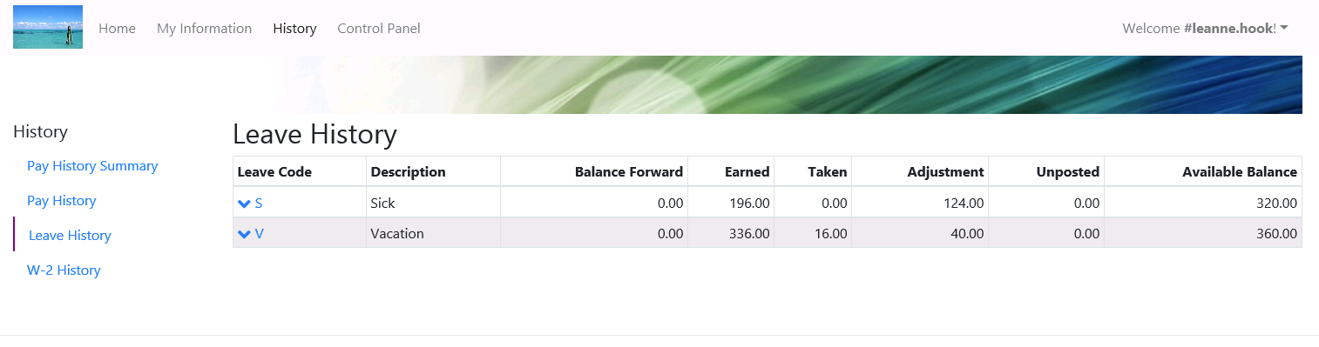
ESS – Leave History
Notes:
The employee can also view their leave information per leave code. <next>

Slide 13
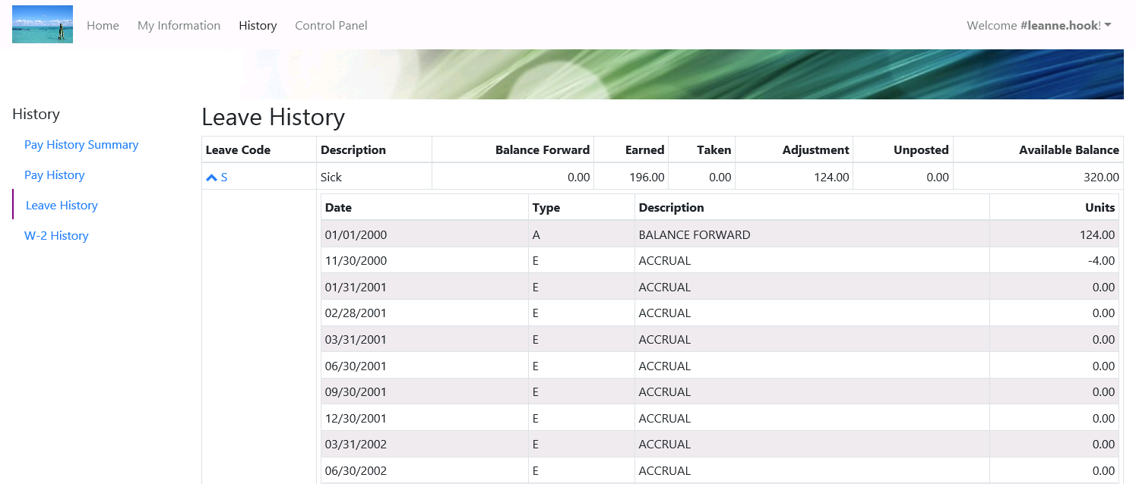
ESS – Leave History Drilldown
Notes:
The Leave Code is a hyperlink. Once clicked, it will expand and show leave history for that leave code. <next>

Slide 14
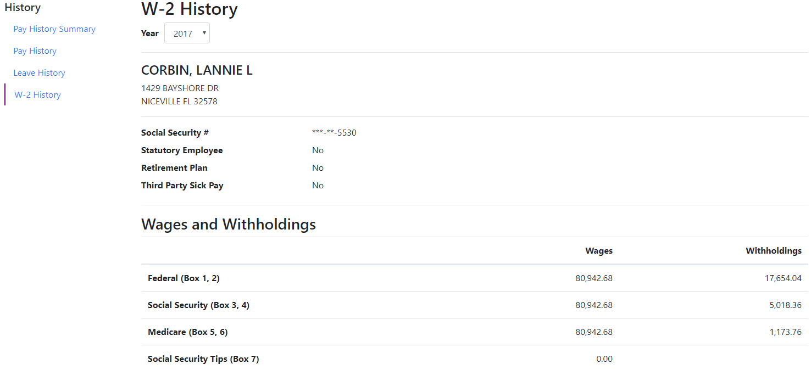
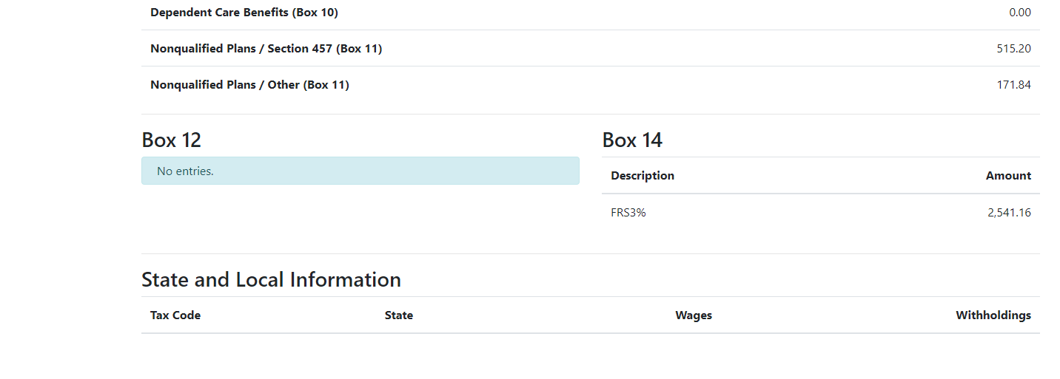
W-2 History
Notes:
We also show W-2 history, however it is not in the W-2 form format. We show the values for each box <next>
This is just an extension of the page to see the rest of the available W-2 information. . If you use Tyler Content Manager, there will be a small document icon in the top right where the employee can open up a pdf of their W-2 to print.
One thing to note, we did not have any w-2 historical storage built prior to processing tax year 2019. So the first history year that will be available to view on ESS will be 2019. From this point forward, history files will be built and stored and can be selected to view in future years. <next>

Slide 15
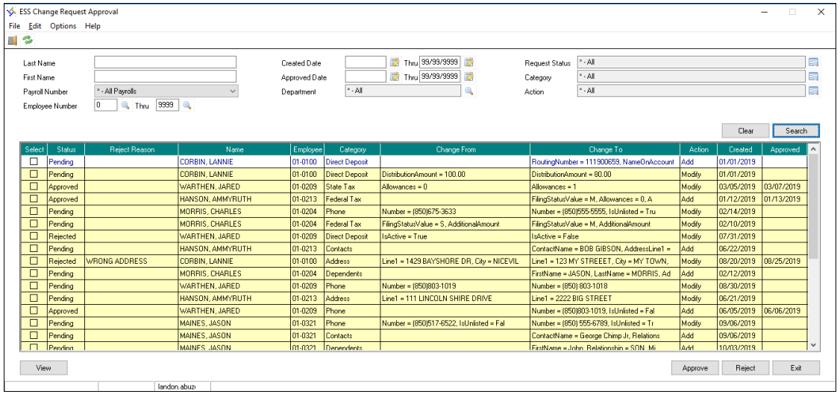
Change Requests in Incode
Notes:
As we saw earlier, an employee can request a change to their name, address, phone, direct deposit information, tax information, and dependents (if licensed for HR) using the green buttons and pencil icons in ESS. The employee will request to make the change within the ESS portal which will flow down into a queue like this. Here a PY supervisor can approve or reject the information change. Once that is done, Incode and ESS will be updated with the new values. <next>

